Slide 1
GPT-ize AI Application

Slide 2

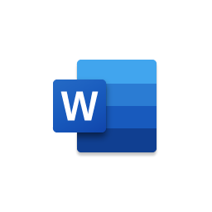
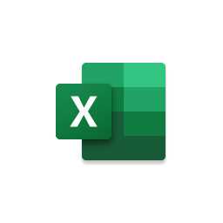





















Enterprise “GPT-ize” Intelligent App Architecture
Client Integration
Secure Frontend Tier
Semantic Compute Engine
Session & Token Data Tier
Non-structured
Data
Cognitive Search
Azure Storage
Mobile App
LLM AI App Dev SDK
Semantic Kernel
Web App
Web-Base App
Azure Cache for Redis
API Management
Azure Function
App Service
Desktop App
Azure CosmosDB
Teams Agent
App Gateway
Container
App
Azure Kubernetes Service
Structured
Knowledge-base
Vector Embedding
Azure Database

Slide 3
Azure Cognitive Search
ingest
abundant
Browse
Cognitive skills
Data in any
format, any
Azure store
Search
Annotations

Slide 4




Cognitive Search Architecture
IEnricher
IEnricher
Cognitive Skill
Document cracking
Skillset:
Extensible and scalable pipeline
Search index
client data
Annotated Documents
Search Index
Azure has built-in cognitive skills OCR, keyword extraction, Sentiment analyzer, computer vision, Form Recognizer, ink recognizer, entity linking,
.pdf
.doc
.jpeg
…
Third Party Enrichers custom classification model, custom entity extraction, Wait.
Text Analytics translation Content Moderator personalize QnA manufacturer speech Wait.
Web
Mobile
Azure machines Learn
Bots
PowerBI

Slide 5


Overview
Product Overview
Accelerate your web and mobile app performance with Azure Cache for Redis, the fully managed and secure cache solution for a seamless and reliable user experience.
Product Offerings
Azure Cache for Redis | Azure Cache for Redis Enterprise
1st Party Microsoft Product Premium Features: Offers basic features such as SSL encryption, monitoring, and backup and restore Business Size: Suitable for small to medium-scale applications that require caching for performance optimization | Developed in Partnership with Redis Inc Scalability: Offers Redis clustering for horizontal scalability and high availability Advanced Modules: Provides advanced features such as persistence, disaster recovery, geo-replication, RedisJSON, and enhanced security Expanded Azure Compatibility: Offers integration with Azure services such as Azure Virtual Network, Azure Active Directory, Functions, and Azure Monitor Resiliency: Suitable for mission-critical applications that require high throughput, low latency, and enterprise-grade capabilities

Slide 6
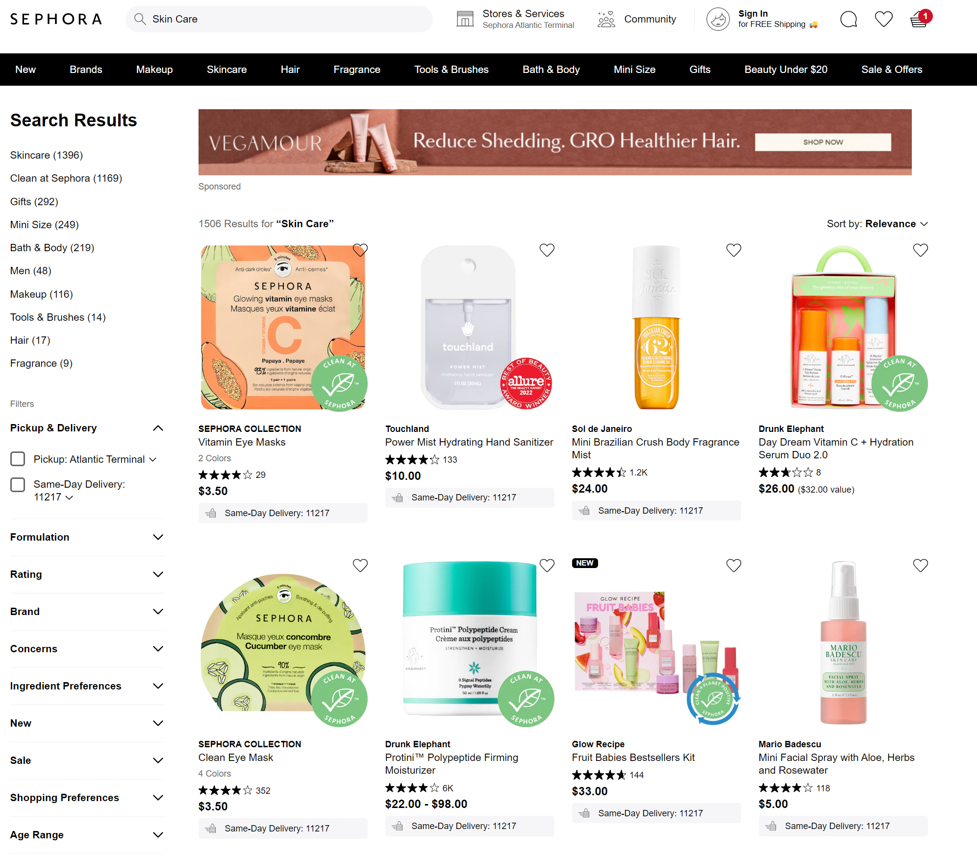





How is Azure Cache for Redis Leveraged?
Session Store
Easily resume a user's journey on any mobile or web application by quickly sorting the data of their last session regardless of where they are across the globe
Message Broker Store
Azure Cache for Redis can communicate across all Microservices. In the example, it communicated with its ad server to give a recommended ad for the shopper
Distributed Cache
All images need to be consistently accessed and are static therefore, minimizes load times by keeping all assets into a cache no matter where the user is across the globe

Slide 7

Function as a Service
Use serverless code to handle events.
Writing cloud apps made easy Extend functionality based on customer needs Develop functions in languages such as C#, Node.js, F#, Python, Java, and more Easily schedule event-driven tasks across services Exposes the function as an HTTP API endpoint
Notes:
https://learn.microsoft.com/zh-cn/azure/azure-functions/functions-best-practices?tabs=csharp

Slide 8
Azure Functions Common application scenarios
Any scenario that requires a response to an event
Real-time stream processing
Timer-based processing
Millions of devices feed into Stream Analytics
Transform to structured data
Store data in SQL DB
Every 15 minutes
Find and clean invalid data
Clean table
Backend (Mobile/IoT/Web)
Real-time bot messaging
?
...
Photo taken and WebHook called
Stores in blob storage
Produces scaled images
Message sent to Chatbot
Chatbot sends
response
Cortana Analytics answers questions

Slide 9

Azure App Service
Accelerate your business
Gain agility by letting developers focus on building new features Bring in your favorite framework, container, or operating system, and standardize how apps are created and edited Get the productivity benefits of a fully managed platform today
Notes:
一个服务，完整的Web或后端API服务
支持代码部署，还支持容器部署

Slide 10
Azure App Service
High productivity for developers and operators
Fully managed
Enterprise-grade
.NET, Node, Java, Docker, PHP, Ruby, Python
Autoscaling and load balancing
Global Data Centers
Deploy containers on Windows and Linux
High availability, automatic update of patches
Hybrid support
Staged and deployed
Reduce O&M costs
Azure Active Directory integration
Testing in production
Backup and recovery
Security & Compliance
App Library Marketplace

Slide 11
Azure App Service Common application scenarios
scenario | solution
Search and discovery | Azure App Service + Knowledge Mining makes it easier to build useful search capabilities directly into your web apps.
Deliver applications at cloud speed anywhere in the world | Azure App Service + Cosmos DB / Azure SQL provides low-latency, responsive web apps across Azure's geographic regions with fully managed SQL and NoSQL databases.
Get there faster and easier | Azure App Service + Azure Maps provides geospatial context for your data to help you create new location-based features within your app.
See, hear, and speak the customer's language | Azure App Service + Cognitive Services provides advanced capabilities such as knowledge mining, machine learning, speech, and language for your applications.
Build powerful integrations to unlock the value of legacy apps | Azure App Service + Logic Apps + API Management creates business processes and automates workflows. Use out-of-the-box connectors to connect legacy on-premises apps to the cloud.
Identify and resolve issues quickly | Azure App Service + Azure Monitor collects, visualizes, and analyzes application performance so you can take proactive corrective action.

Slide 12
Azure Kubernetes Service
Use Kubernetes to extend and orchestrate Linux and Windows containers
Accelerate containerized application development Docking with many upstream and downstream services on the Azure platform Easily manage, monitor, and secure your containers
Notes:
一个服务，完整的Web或后端API服务
支持代码部署，还支持容器部署

Slide 13
AKS is a Kubernetes cluster hosting service provided by Azure
Free users from cumbersome K8S O&M and focus their time and energy on business innovation!
Automatic upgrades, patches, no downtime Simplify cluster management Cluster services are free and you only pay for compute node resources AKS has a wealth of unique capabilities
100% compatible with open source communities Fully managed clusters Automated management and operations There is no billing for the control node Simple and easy to use AKS is uniquely capable of: Automatic capacity scaling of the cluster Azure container networking model Azure Storage (Disk / File) ACI container instances Windows container Integrated monitoring Azure Monitor Azure DevOps Integrate with Azure service
managed
Application architect
app
ops
Kubernetes
Infrastructure architect
Docker
Azure Infrastructure services

Slide 14
AKSCommon usage scenarios
Modernize business-critical applications
SaaS delivery
Real-time telemetry
Geographically distributed applications
Notes:
容器是云上PaaS最主力的计算资源，几乎可用于任何场景,能够体现其优势的主要还是需要速度、可靠性和安全的场景，包括
业务关键应用的现代化。 交付SaaS解决方案， 实时遥测（来自设备、汽车、智能建筑等）， 为地理分布的用户提供服务

Slide 15

Azure API Management
Securely publish APIs to connect and manage back-end systems running anywhere
Manage APIs across cloud and on-premises Help protect resources Accelerate your business Improve API ease of use Convert an existing service
Notes:
跨云和本地管理 API
将 API 网关与 Azure、其他云中和本地的 API 进行并行部署，以优化 API 通信流。不仅能满足安全性和符合性要求，同时还能实现所有内部和外部 API 的统一管理和完全监测。
帮助保护资源
通过应用身份验证、授权和使用限制，控制向员工、合作伙伴和客户公开数据和服务的方式。
加速业务发展
通过 API 优先的方法更快地构建应用并为客户带来即时价值。通过 API 模拟，API 修订版和版本控制以及自动化 API 文档分离前端和后端团队。了解连锁超市 Wegmans 如何在不到八周的时间内就创建了新的移动应用程序
提高 API易用性
为所有 API 创建可自定义的开发人员门户。轻松地与内部团队、外部合作伙伴和客户管理并共享 API。
转换现有服务
通过为后端服务创建外观，自动将旧版 Web 服务转变为基于现代 REST 的 API。了解像挪威领先的支付服务公司 Vipps 这样的创新者如何使用 Azure API 管理改革开发工作。

Slide 16





















Azure API manage
Developer portal
API
Discover Learn Test Online Get help
Abstraction and decoupling Security & Protection Revisions and versions Monitoring and measurement Publish and monetize
application developer
Management plane
API vendor
User plane
gateway
employee Partners client
Data plane
application and equipment
Microservices

Slide 17
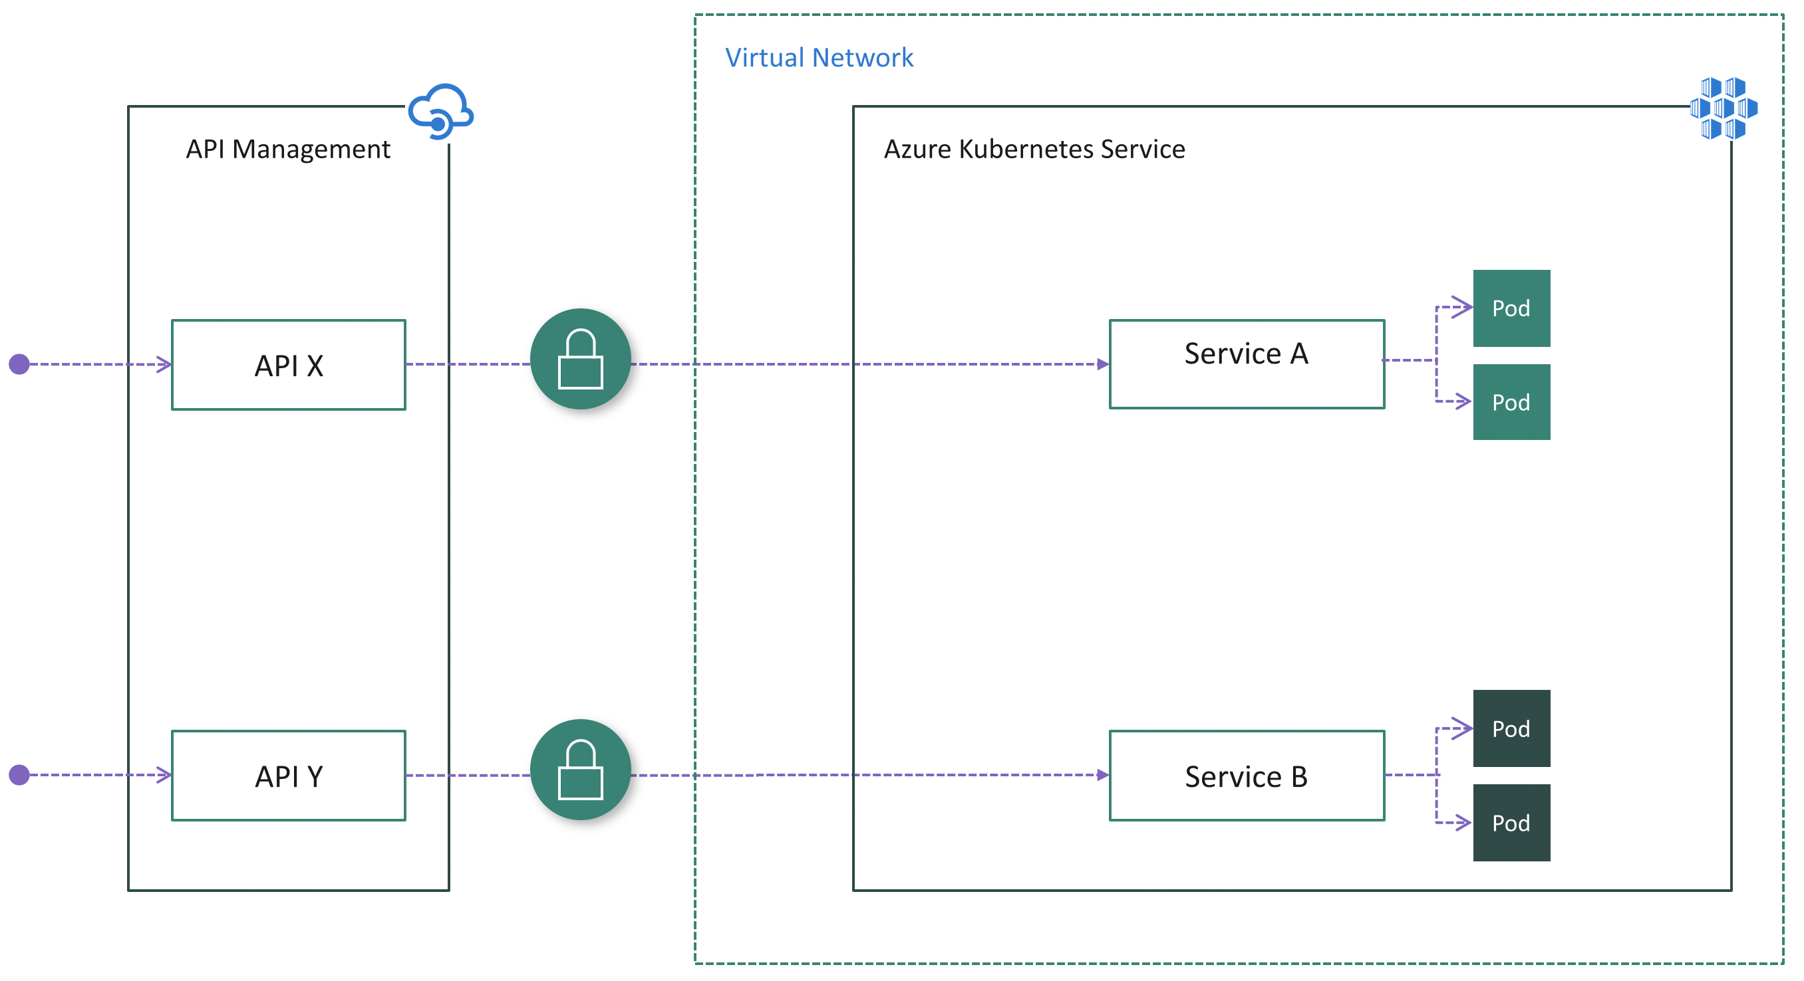
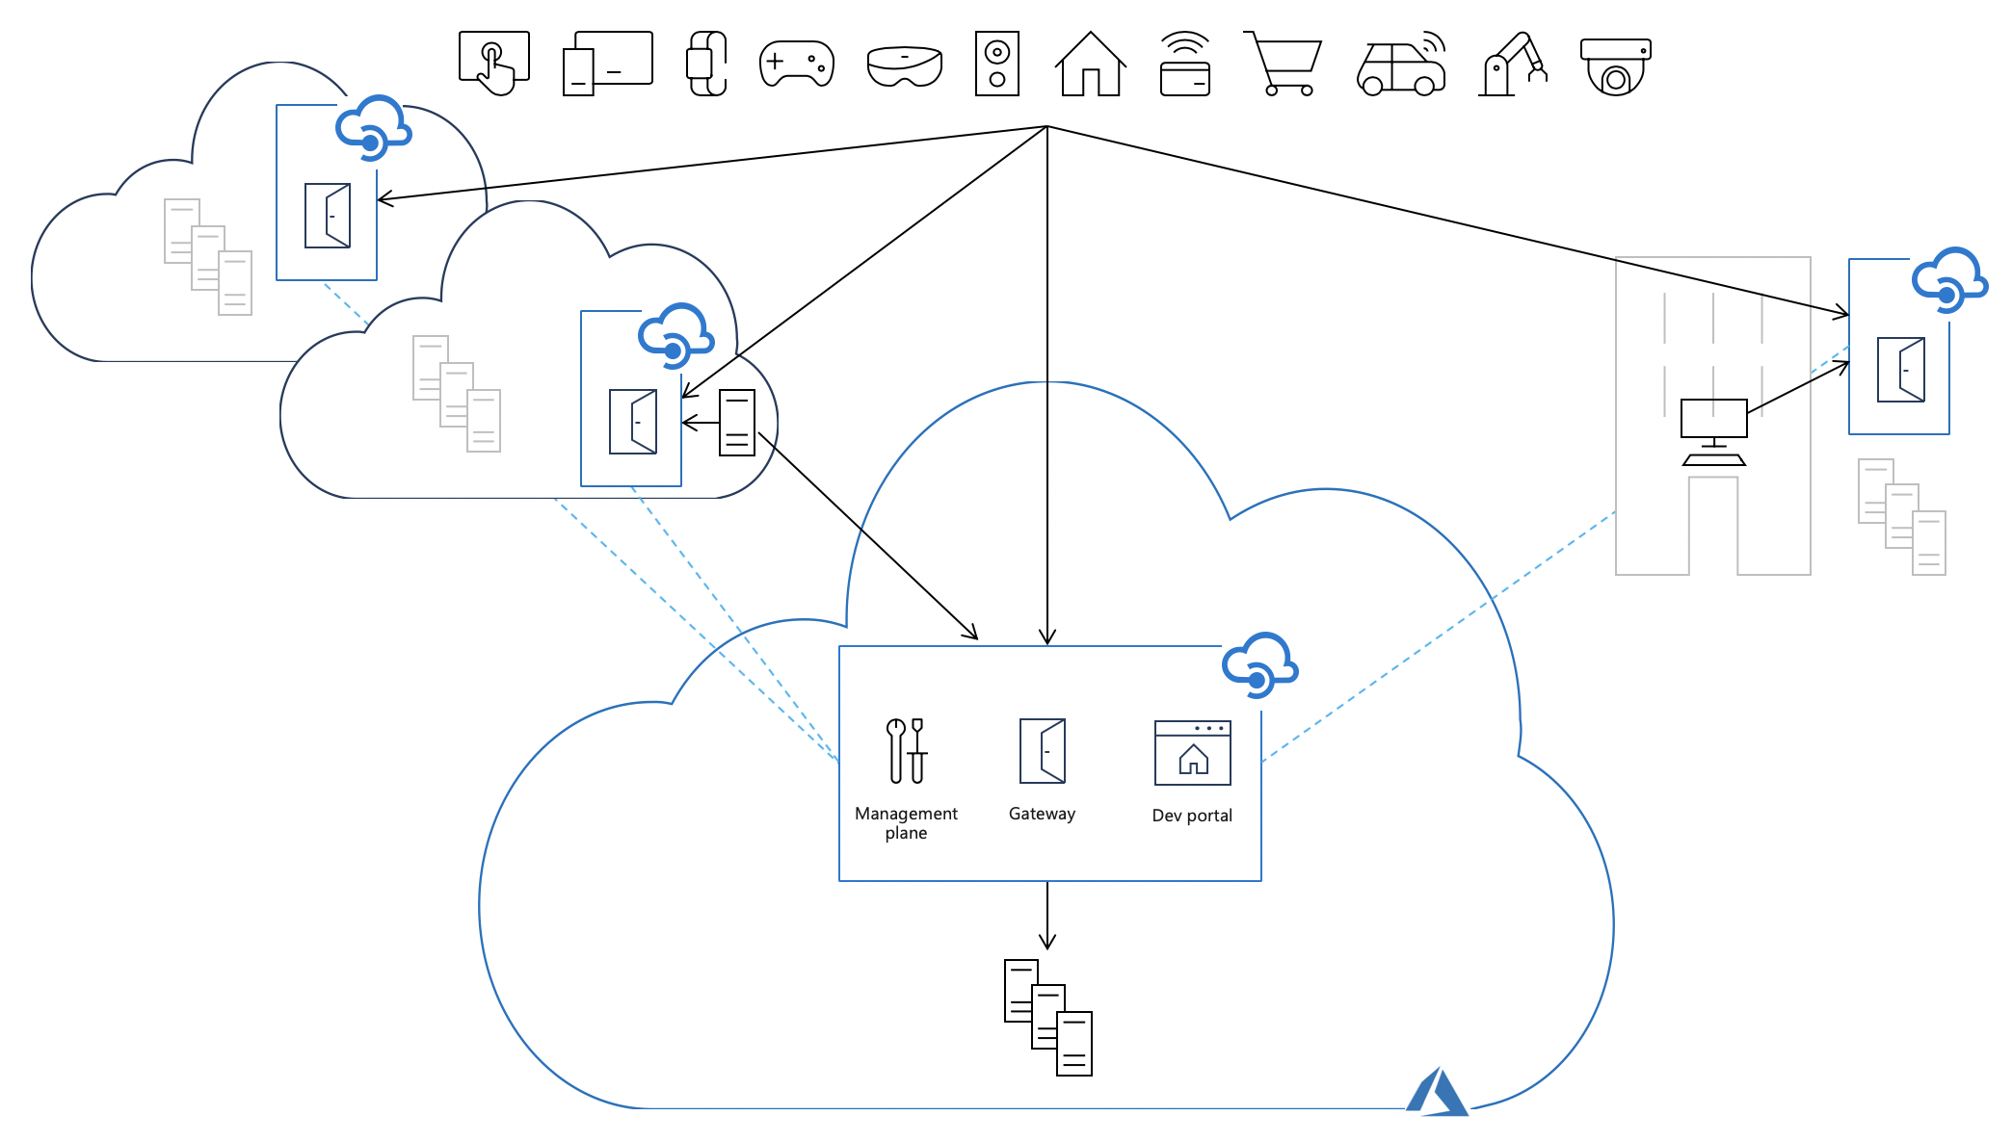
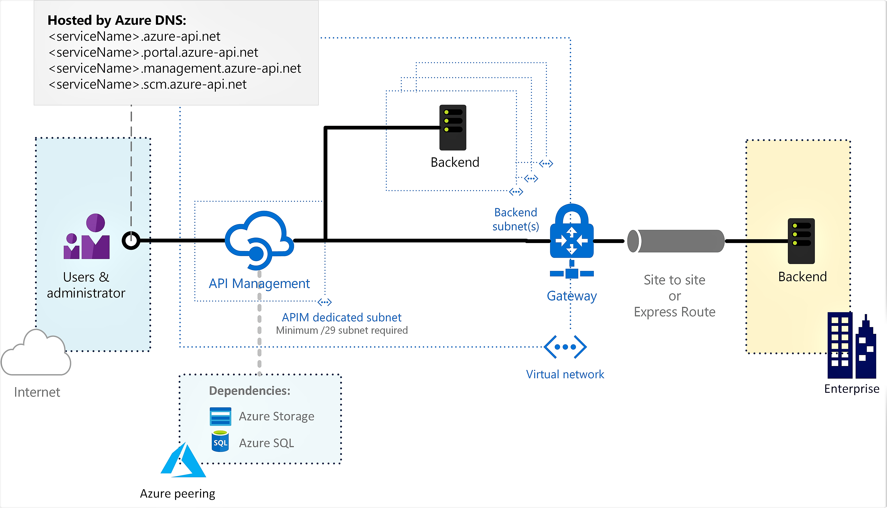
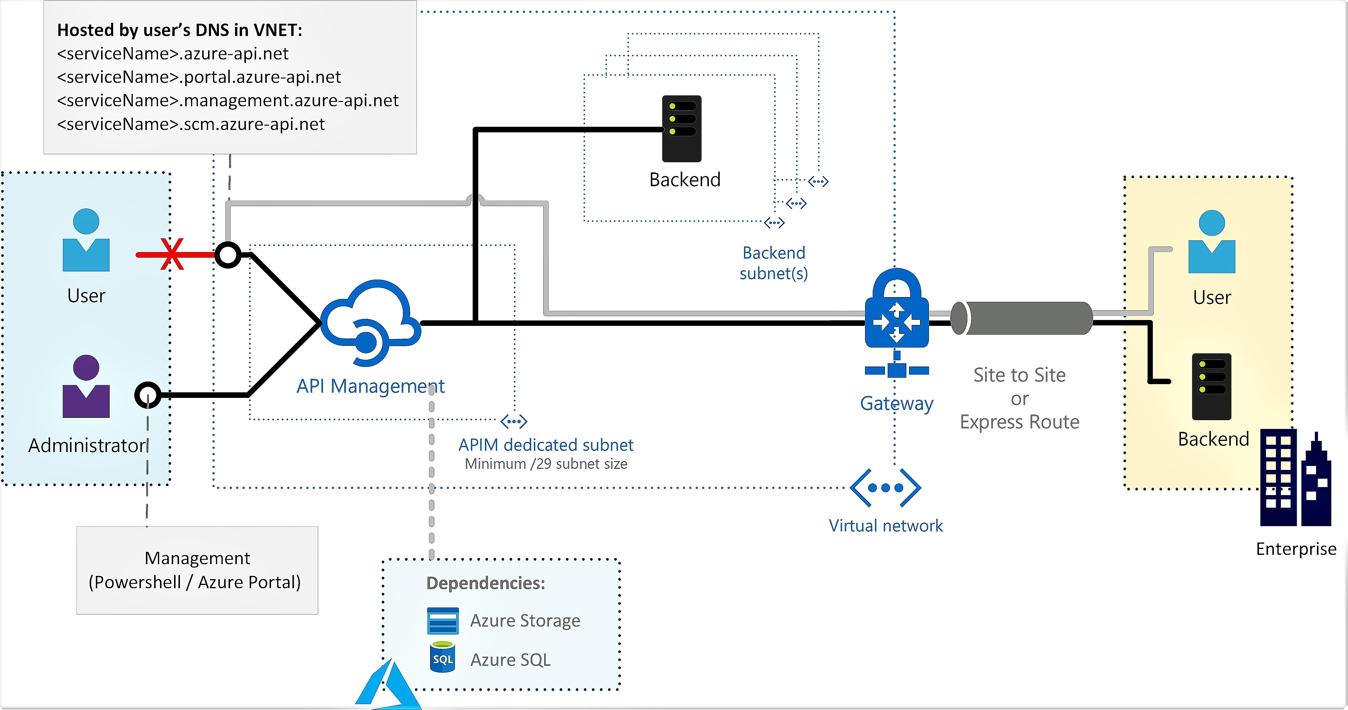
API Management usage patterns
Mode 1: Internet service, Internet connection to the backend
Mode 4: Local gateway, which runs locally on the backend
Mode 2: Internet service, intranet/leased line connection to the backend
Mode 3: Intranet service, intranet/leased line connected to the backend

